Slide 1
Are You at the Risk of Heart Disease?
France Guieb, Zohaib Hashmi, Beth Scott, Snehitha Soma, Anjana Bandara

Slide 2
Tools
Data
Pandas
ML -Models
Python – Flask
HTML/CSS
Javascript
Tableau
Heroku

Slide 3
Data & Data
Data source/data cleaning | Kaggle.com Cardiovascular Disease Dataset | Cleaning the Dataset Data drop Age Gender Blood pressure values Cardio variable
limitations | Size of dataset (70,000 lines) Hosting AWS (cost) Heroku limitation 10,000 lines Tableau Public data input | How can we increase machine learning model by improving efficiencies for better accuracy

Slide 4
Web Page

Slide 5
System Architecture
DATA
TABLEAU
PANDAS
PYTHON
FLASK
HTML/CSS
JAVASCRIPT
INPUT
ML MODEL
OUTPUT

Slide 6
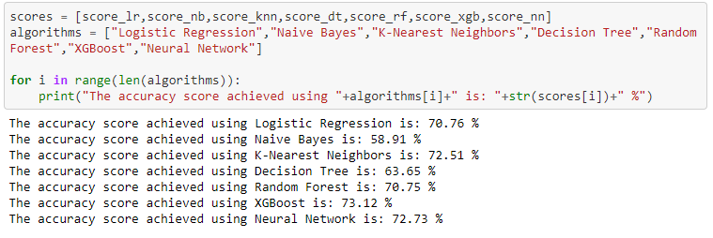
Prediction of Risk

Slide 7
Prediction of Disease

Slide 8

Questions?

